Slide 1
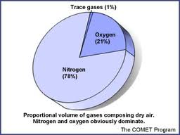
The Nitrogen Cycle
The nitrogen cycle - nitrogen circulates among the air, soil, water, plants, and animals in an ecosystem.
All organisms need nitrogen to build proteins, to build new cells.
Nitrogen makes up 78 percent of the gases in the atmosphere.

Slide 2
The Nitrogen Cycle
Nitrogen must be altered, or fixed, before organisms can use it.
Bacteria known as “nitrogen-fixing” bacteria can fix nitrogen into chemical compounds that can be used by other organisms..

Slide 3
The Nitrogen Cycle
Nitrogen-fixing bacteria convert atmospheric nitrogen into ammonia.
These bacteria live in the roots of plants called legumes, (beans, peas, and clover).
Excess nitrogen is released into the soil.

Slide 4
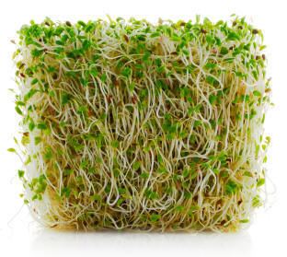
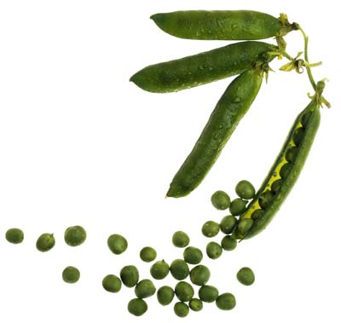
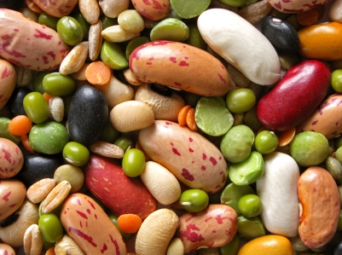
Legumes

Slide 5
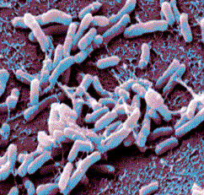
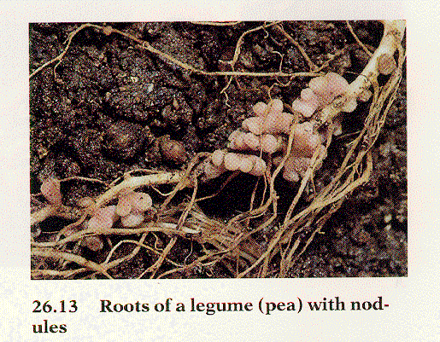
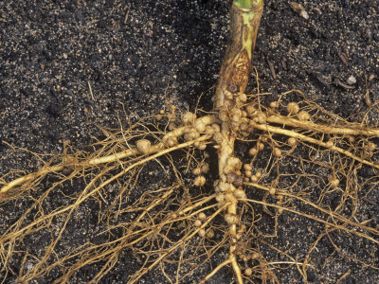

Slide 6
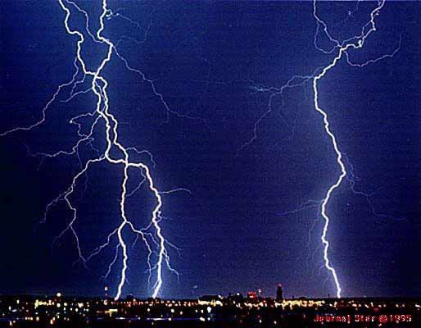
The Nitrogen Cycle
Nitrogen can also be fixed in the atmosphere by lightning

Slide 7
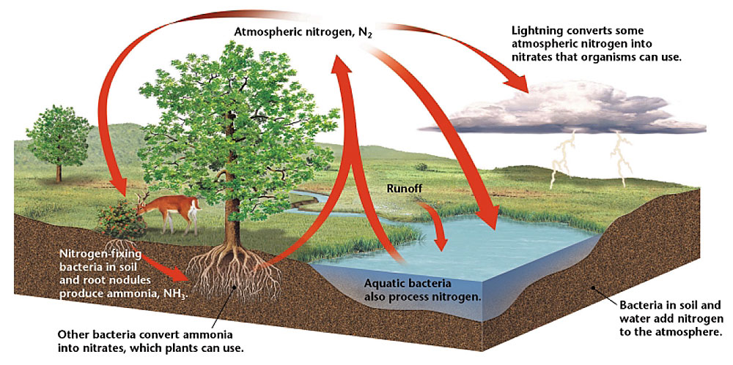
The Nitrogen Cycle

Slide 8
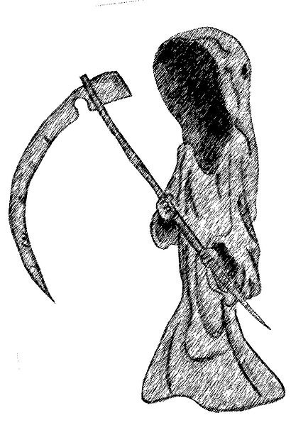
Decomposers and the Nitrogen Cycle
Nitrogen stored within the bodies of living things is returned to the nitrogen cycle once those organisms die.

Slide 9
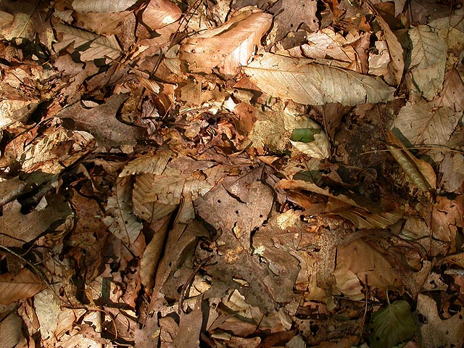
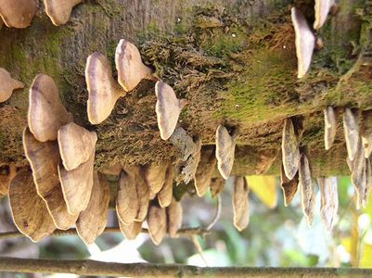
Decomposers and the Nitrogen Cycle
Decomposers break down decaying plants

Slide 10
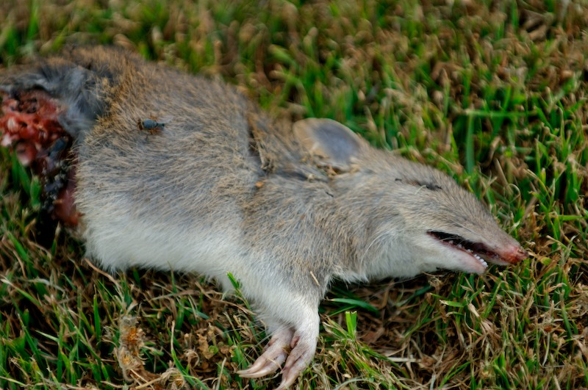
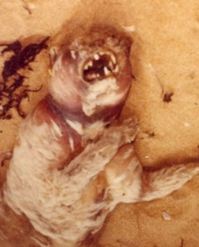
Decomposers and the Nitrogen Cycle
Decomposers break down decaying animals

Slide 11
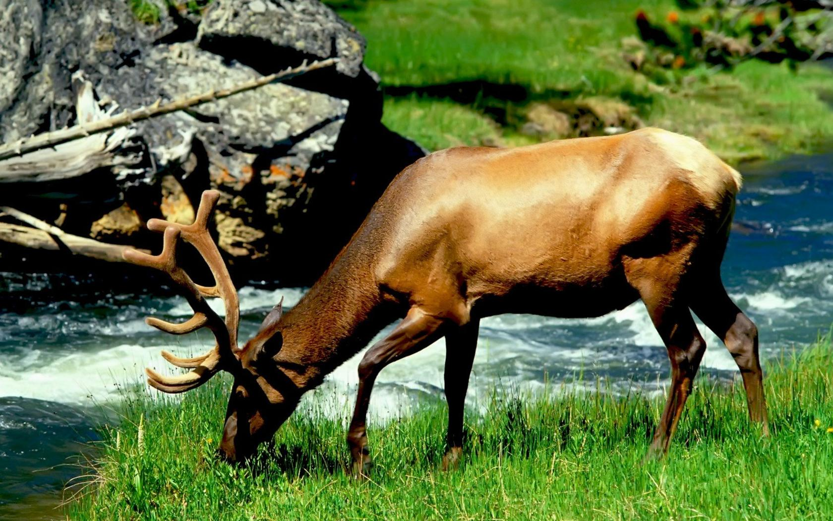
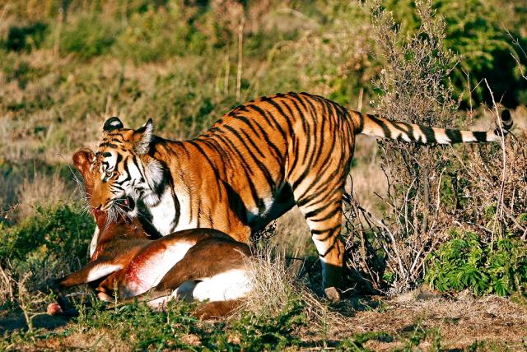
Nitrogen Cycle
Animals receive their nitrates from eating plants or other organisms

Slide 12
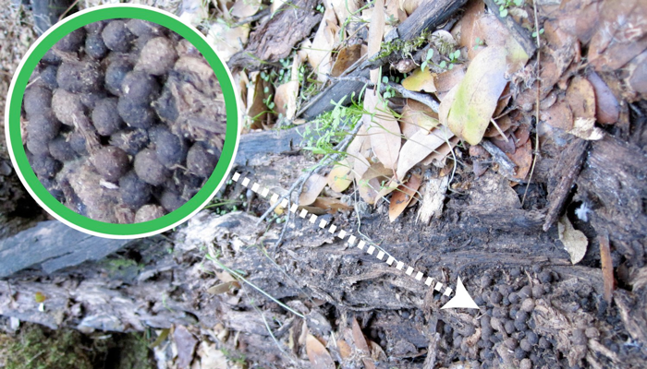
Decomposers and the Nitrogen Cycle
Decomposers break down decaying plant & animal waste. Nitrogen goes back into ground and atmosphere

Slide 13
The Nitrogen Cycle

